Slide 1
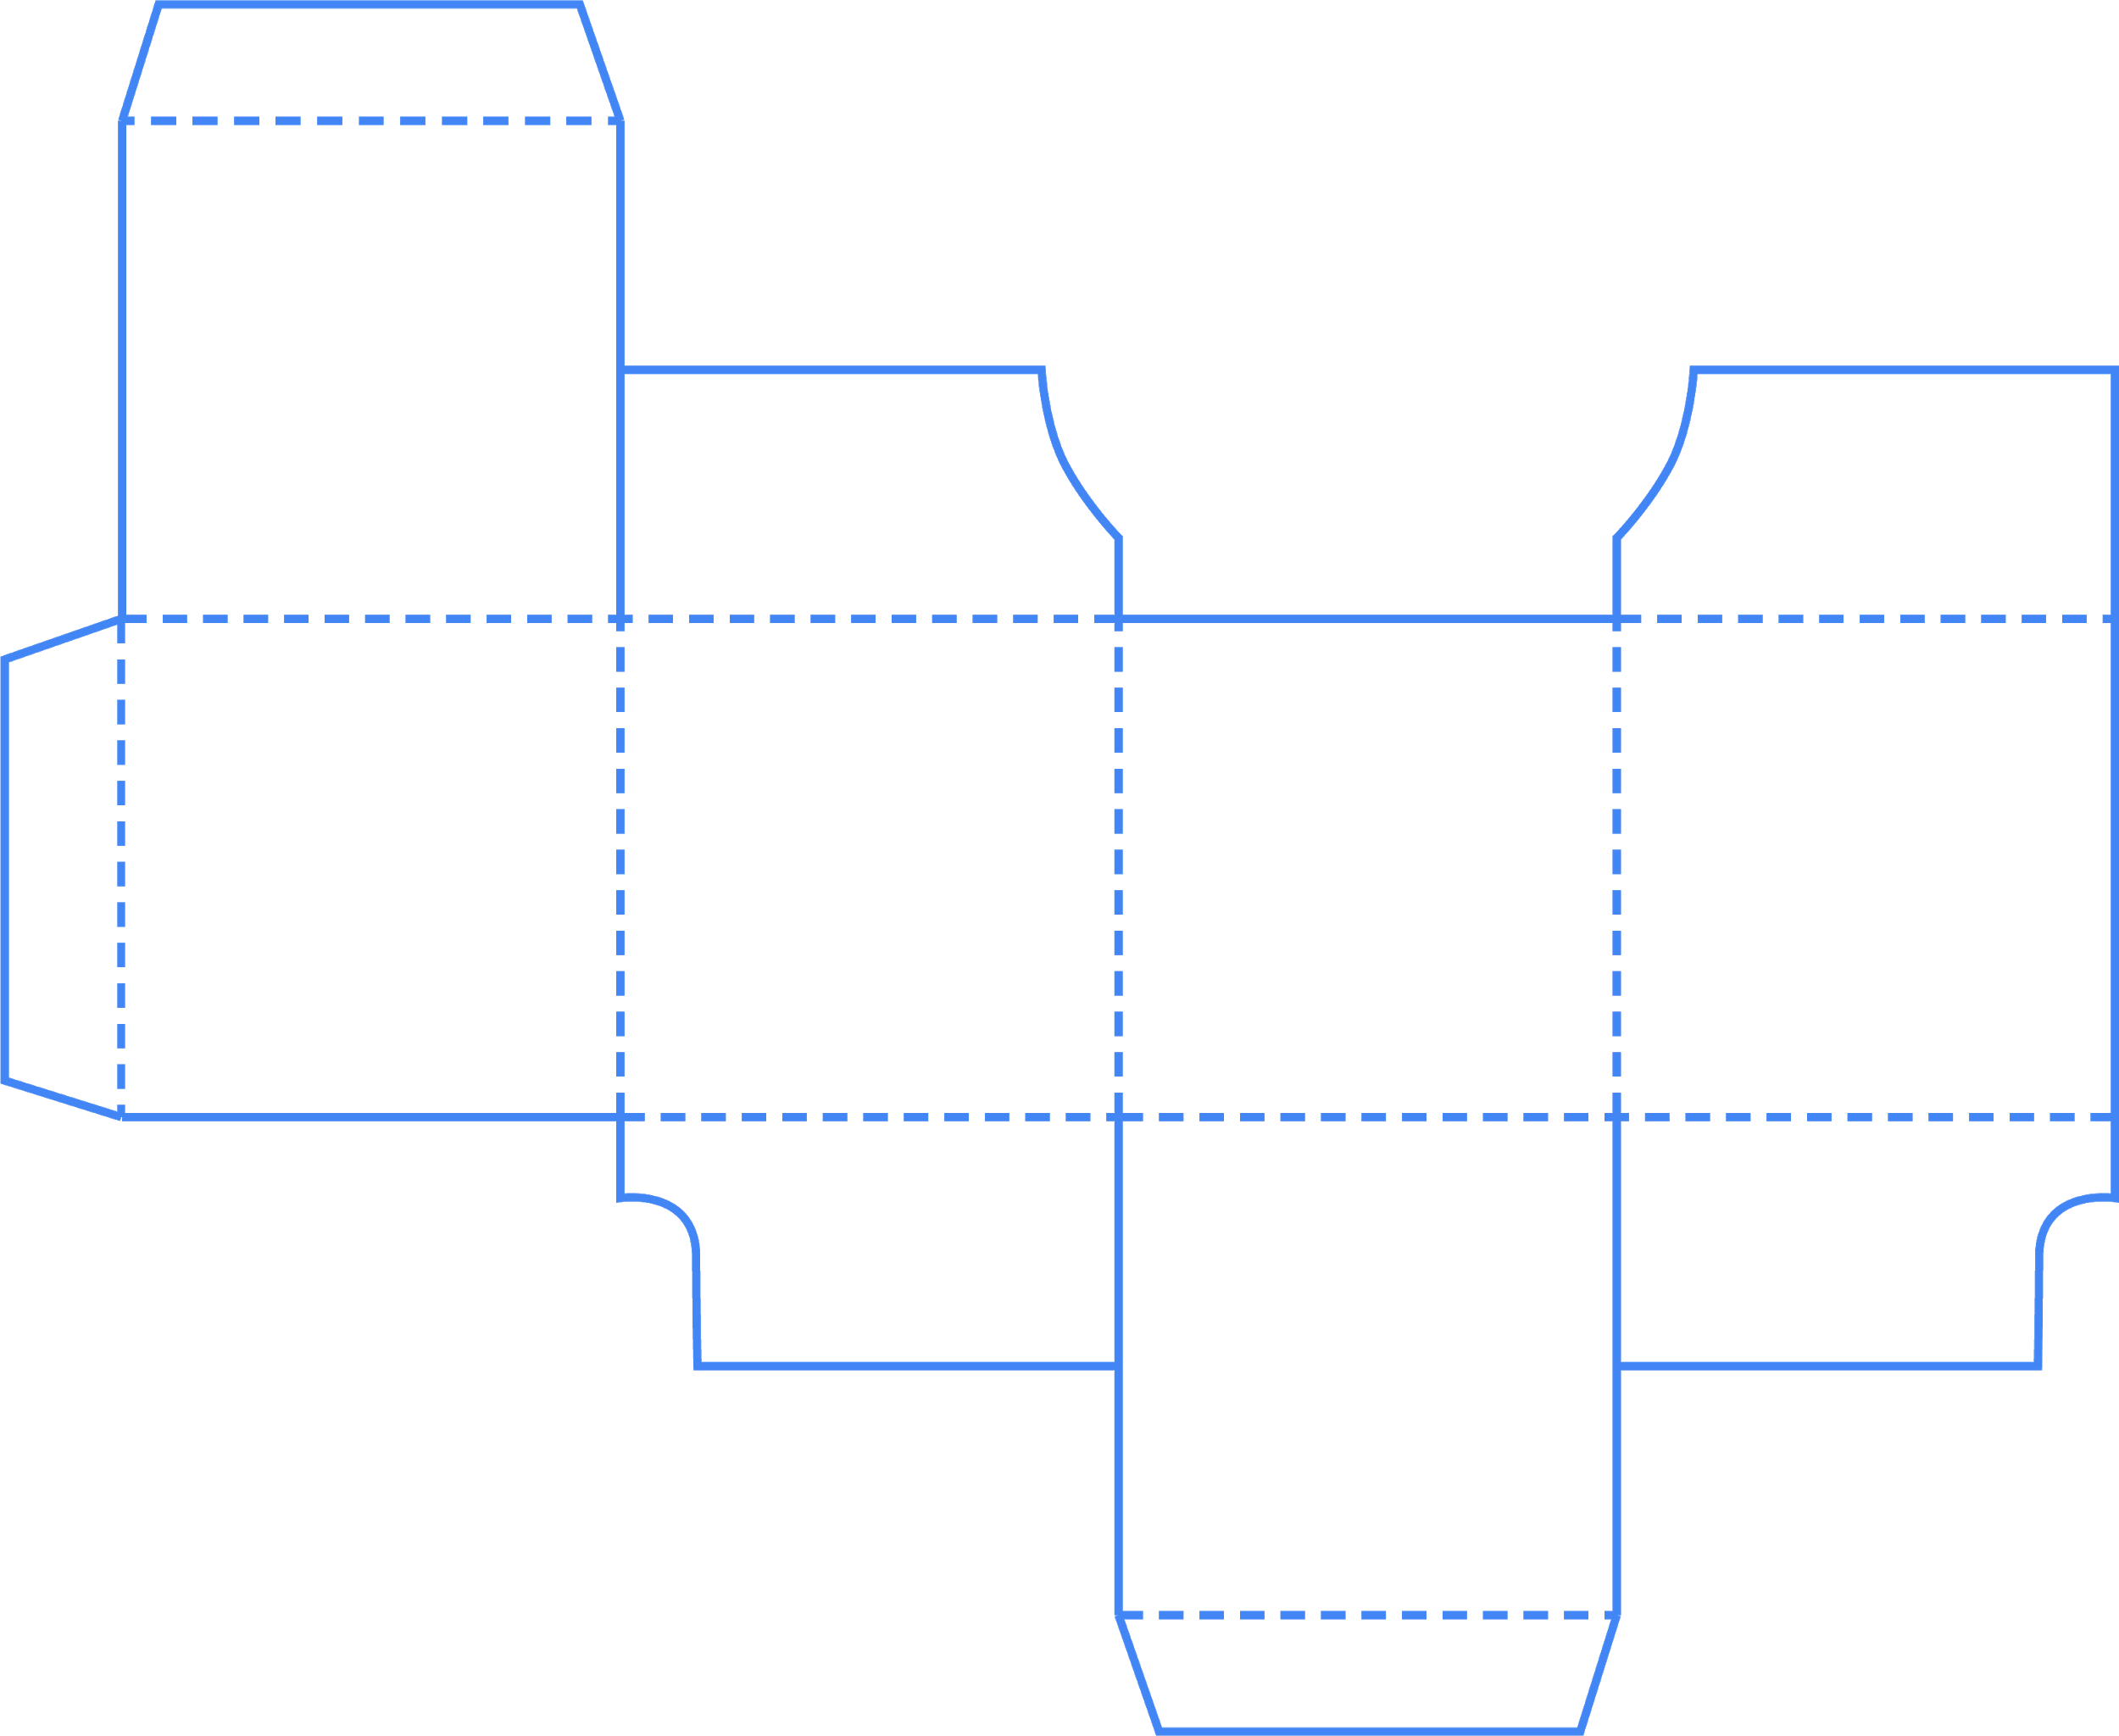

Cubing
Materials
Method
Expertise
Timings
Testing
Argue for & against it
Cubing prompts you to consider your topic from six different directions — to cover all sides of a cube. You can then review your answers and look for themes or anomalies. What do they tell you?
Cut out this mini-cube along the solid lines. Fold along the dotted lines. Tape or glue the sides if needed.
Roll the cube and begin the design process depending on the section you land on. By the end, you should have completed all areas, giving you a robust design brief.
Your first roll doesn’t mean your last. Look at the answers and think about what you can change. This is called refining.
Keep working on your brief and see how it evolves until you reach the optimum design.
4. Design the test
Activity 1

